Slide 1
Geographical Information System (GIS)

Slide 2
What is GIS?
A geographical information system (GIS) is a system designed to capture, store, manipulate, analyse, manage, and present all types of spatial or geographical data.
In simple terms, the term describes any information system that integrates, stores, edits, analyzes, shares, and displays geographic information.

Slide 3
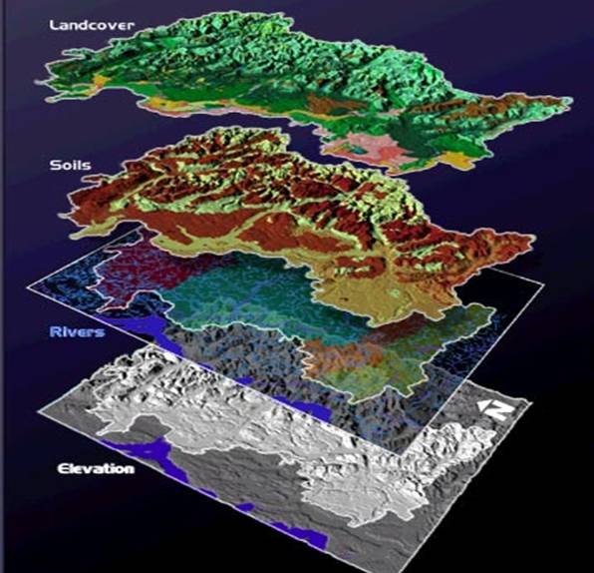
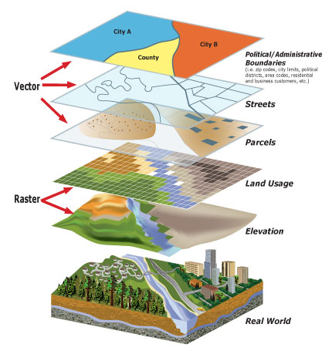

Slide 4
GIS Techniques n Technology
The most common technique is digitization of the maps. Wherein several pictures of an area is being captured then stitched together using CAD soft wares.
Relating information from different sources:
GIS uses space-time location as the key index variable for all information. Location is used a key index to join unrelated information.
GIS uncertainties :
development of digital topographic database are based on topographical maps are the main source but aerial photography and satellite imaginary add details to these digital databases. These collected data have to processed to bring to theoretical scales

Slide 5
Data Representation:
GIS represents data by mixing real objects with digital data. The real objects are further divided depending on whether it is a geographical feature or some sort of construction.
Data Capture:
data for the representation is captured either by using the existing maps which are digitized then or by entering survey data that is collected or from images that are captured with the help satellites or drones.

Slide 6
Applications
GIS is not interoperable ie, GIS developed for one application cannot be used for another.
Web Mapping:
mapping application like google maps , bing maps etc use these GIS data for their functionalities.
APIs are made to make the use of these data easier.
Since the conditions of the earth changes from time to time there is one more aspect that is being added which is time.

Slide 7
GIS using Drones
Drone technology allows GIS professionals to work more effectively.
Easy to deploy mapping drone
Convert aerial view into 2-D or 3-D views.
UAVs/UAS technology effectively complements existing techniques.

Slide 8
GIS workflow
Drone acquisition & generation of raster data:
Flight planning
Flights
Image download & processing
Generation of digital surface models
Extraction of vector data
GPS recording
Geodatabase
Manual Data Collection
Digitisation
Web Services
Drone point cloud

Slide 9
Import & layering of vector & raster data
GIS software
Analysis & decision making
Progress tracking, feature identification, flood simulation, project planning etc.

Slide 10
Companies using GIS
ESRI:
Built software, ArcGIS for connects maps, data and help people .
ESRI is used in all fields, government, commercial, natural resources , utilities.

